Slide 1
ASP.NET MVC CORE
Instructor: Edwin oduor

Slide 2

Quote of the day

Slide 3
Lesson objectives
Return Url

Slide 4
Lesson pre-requisites
In order to take full advantage of this section you need to have the following;
Computer with Visual Studio Installed.
Stable Network Connection.

Slide 5
Training methods and extra readings
TRAINING METHODS FOR THIS LESSON
EXTRA READINGS
Lecturing Method – This is the main method of training to be adopted in this lesson with illustrations and practical coding examples.
Discussion Method - This method will be adopted periodically whereby learning will be derived principally from the students brainstorming together, rather than from the trainer. Three main types of discussions will be used:
Directed discussion
Developmental discussion
Problem-Solving discussion
Home and Learn C#

Slide 6
Return url

Slide 7
When a user clicks on a link and they are not logged in the user will be redirected to the login page, the return URL what it does it keeps hold of the URL that the user had clicked on, therefore as a developer one can use the return URL to redirect the user to that particular link they had clicked before logging in. In the image below there is a return URL as shown.
Normally when a user login the return URL is going to disappear what we want to do is instead of disappearing will use what is in the URL so that we direct the user to the URL the user had clicked on before login.

Slide 8
When a user clicks on a link then whatever is clicked is showed in the return url. The moment the user enters their credentials and enters into the system then the system will redirect the user to the home page of the system and whatever was in the return url is lost.
What we want to do is to use the return url to capture what’s there and use it when a user login then will be taken to the page that they had clicked before they logged in.
To achieve this in our login method will have another parameter that is going to capture what’s in the return URL.

Slide 9
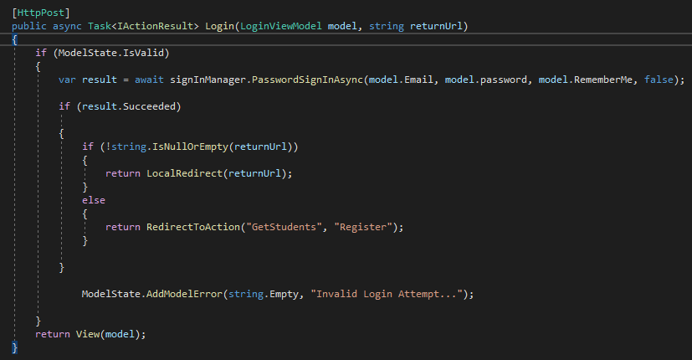
The login method will now look like this.

Slide 10
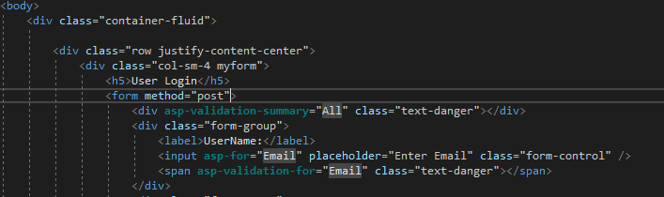
In the login method the second parameter is being passed, then using if statement to check if the return URL has something when the user is logging in then the system is going to redirect the user to the address that is in the URL.
Once this is done slight amendment need to be done on the form we need to get rid of asp-action and asp-controller, what we will be left with is method =“post”

